Slide 1
SCRUM MASTER AND
PRODUCT OWNER BOOTCAMP
RSM+RPO

Slide 2


PRODUCT
INCREMENT
SCRUM BOOTCAMP

Slide 3

Product Increment
The product increment is the sum of all backlog items completed during the sprint.
At the end of the sprint, the new increment must be done.
Each increment is additive to all prior increments and must be thoroughly tested, ensuring all increments work together.
The increment must be in usable condition whether or not the PO decides to release it.

Slide 4
Acceptance Criteria and Definition of Done
DoD is a set of fixed criteria we apply to all user stories in a product. Think of it as a quality mark when shipping the completed stories.
You should simply be able to rubber stamp each story as having met a master set of standards.
Acceptance Criteria, also known as ‘conditions of satisfaction’ are applied to an individual user story, and are used to confirm that the desired purpose of the story is met.
These should be written as a team. The PO might start, but the team must work together to create the AC.

Slide 5

SPRINT
REVIEW
SCRUM BOOTCAMP

Slide 6

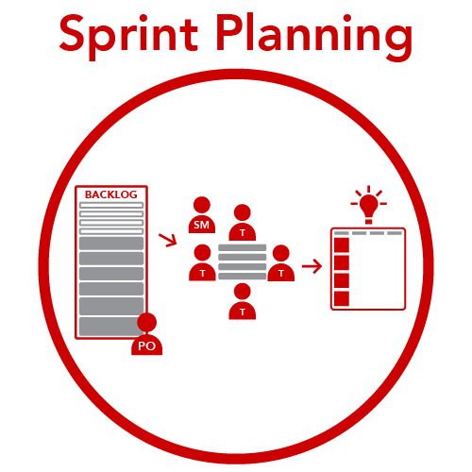








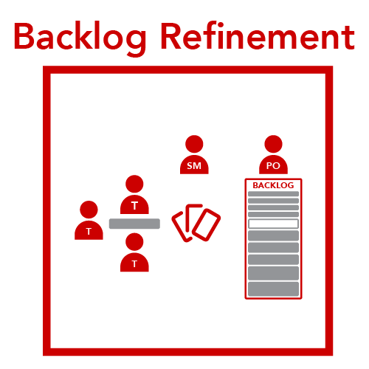

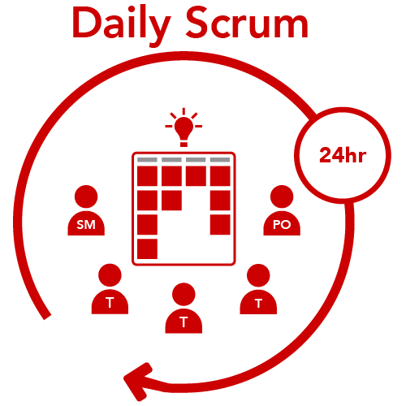



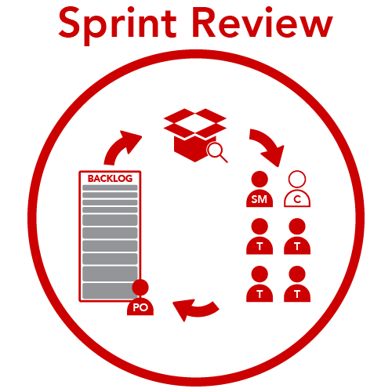




The Scrum
Framework

Slide 7

Sprint Review
The Fundamentals
Primary Goal:
Feedback – Improve the Product!
Time Box:
1 hour or less per week of Sprint
Who’s Involved:
Scrum Master
Product Owner
Developers
Stakeholders
Who’s Owns It:
Product Owner
Notes:
In this event, the team will demonstrate their product increment and solicit feedback from key stakeholders. The PO facilitates this event.

Slide 8
Sprint Review
An Agenda
SET THE STAGE
WHAT DID WE DO?
HOW DO WE RESPOND?
What was our Sprint commitment?
What did we complete?
What affected our Sprint?
What are we demonstrating?
What is our release burndown?
What undone work remains?
What changes need to be made to the backlog?
What issues or concerns need to be addressed?
What is our action plan?
Adapted from Jean Tabaka “Collaboration Explained”

Slide 9
Team Agility Scale
Sprint Review
Unsatisfactory use of technology
No direct customer feedback is obtained
Cannot demonstrate working product at end of Sprint
Involves direct feedback from customers/stakeholders
Customers/stakeholders aware of intended and actual sprint outcomes
Working product demoed at each review
Completed PBIs are inspected within the context of the product as a whole.
Team/customers/stakeholders discuss how to optimize product value
Team members actively listen to and absorb customer feedback
Customers are viewed as part of the team
Employs mitigation strategies to overcome cognitive biases
Notes:
Exercise (Conclusions): Ask the teams to look at the Team Agility chart - chose one item in the ‘underperforming’ column that your team is experiencing, and write down how you are going to fix it after the training is over.

Slide 10

SPRINT RETROSPECTIVE
SCRUM BOOTCAMP

Slide 11
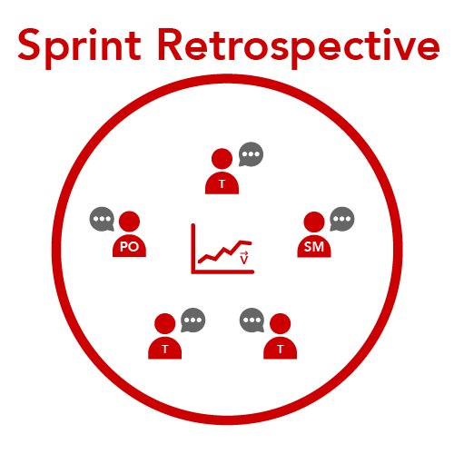
The Scrum
Framework

Slide 12

Sprint Retrospective
The Fundamentals
Primary Goal:
Kaizen – an experiment to get better
Time Box:
45 min or less per week of Sprint
Who’s Involved:
Scrum Master
Product Owner
Developers
Who’s Owns It:
Scrum Master
Notes:
The most valuable event for long-term team performance. Effective facilitation is the Scrum Master’s top priority

Slide 13

Sprint Retrospective
The Kaizen
To pursue continuous improvement, the team should develop at least one Kaizen story (improvement experiment) every Sprint.
The Kaizen is the top priority story in the next Sprint backlog
While several process improvement opportunities may be identified, only one experiment should be conducted in each Sprint.

Slide 14
Sprint Retrospective
The Long Term Effect
Effective velocity over time
(without retrospectives)
VELOCITY
Effective velocity over time
(without retrospectives)
1
2
3
4
5
6
7
8
9
10
11
12
13
SOURCE: HENRIK KNIBERG

Slide 15


Sprint Retrospective
An Agenda
SET THE STAGE
GATHER DATA
GENERATE INSIGHTS
The first Scrum team had the Sprint Review and Retro as one meeting. Ken was asked, particularly by Esther Derby, to break it out as a separate meeting a few years after the Agile Manifesto Meeting.
DECIDE WHAT TO DO

Slide 16
Team Agility Scale
Retrospective
One or more team members is/are absent
Members are bored/not interested
“This is a safe place” used in place of actually establishing a Pysch Safe env.
Exercise does not mitigate Group Think
No actionable lessons learned or kaizen not identified
Team members fail to correctly perceive events/situations (cannot reconstruct the "what")
Demonstrates the use of a simple, repeatable, and scalable retro exercise
Retro exercise observed being used outside of scheduled retro
All team members can restate team / sprint goal
Team works to identify “What” happened then moves to understanding “How” and “Why”
Team actively mitigates cognitive biases/challenges assumptions
Kaizen identified and added to sprint backlog
All team members can lead an effective retro
Multiple perspectives are shared and valued
Team members actively display fallibility
Team members provide constructive feedback
Root cause(s) are identified
Applicable Lessons shared across organization
Notes:
Exercise (Conclusions): Ask the teams to look at the Team Agility chart - chose one item in the ‘underperforming’ column that your team is experiencing, and write down how you are going to fix it after the training is over.

Slide 17
Sample Sprint
Schedule
 | 8A | 9A | 10A | 11A | N | 1P | 2P | 3P | 4P
Mon
Tue
Wed
Thu
Fri
Daily Scrum
Planning
Refine
Review
Retro

Slide 18
Sample Sprint
Schedule
 | 8A | 9A | 10A | 11A | N | 1P | 2P | 3P | 4P
Mon
Tue
Wed
Thu
Fri
Daily Scrum
Planning
Refine
Review
Retro

